Slide 1

By
Athira M P
Santhosh Maurya
Shyam Rawat
Aniket Pawar

Slide 2
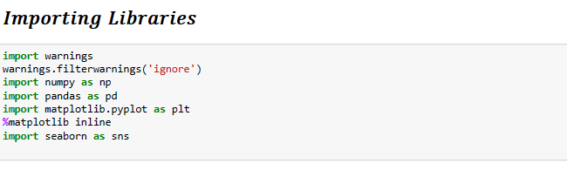
Problem Statement
A Study on Employee attrition prediction through Explorary Data Analysis and Machine Learning
IMPORT LIBRARIES

Slide 3
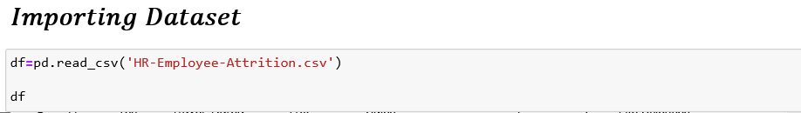
IMPORT DATASET
We used the "IBM HR Analytics Employee Attrition & Performance" dataset made available on Kaggle for our project.
The dataset can be used to develop machine learning models to predict employee attrition and to explore the factors that contribute to attrition in the company.
INSIDES OR VARIABLES
* Age
* Daily Rate
* Distance From Home
* Environment Satisfaction
* Hourly Rate
* Job Involvement
* Job Level
* Job Satisfaction
* Monthly Rate
* Percent Salary Hike
* Relationship Satisfaction
* Total Working Years
* Work Life Balance
* Years At Company
* Years In Current Role
* Monthly Income
* Attrition
* BusinessTravel
* Department
* EducationField
* Gender
* JobRole
* MaritalStatus
* OverTime

Slide 4
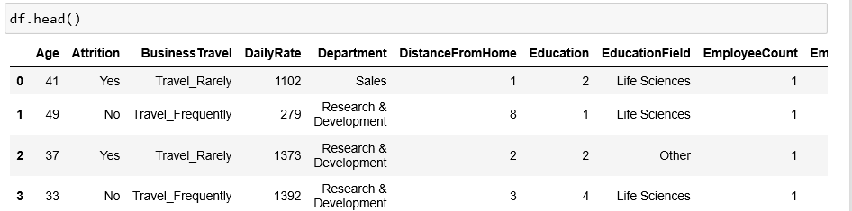
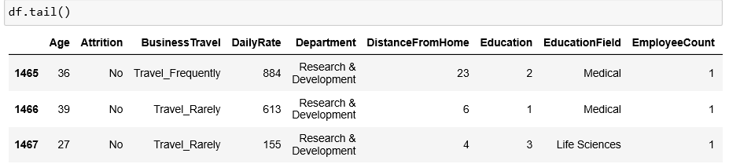

Display Head and Tail
Display Number of Row & Columns

Slide 5
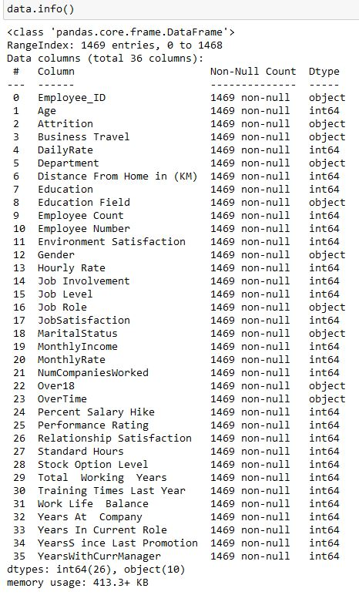
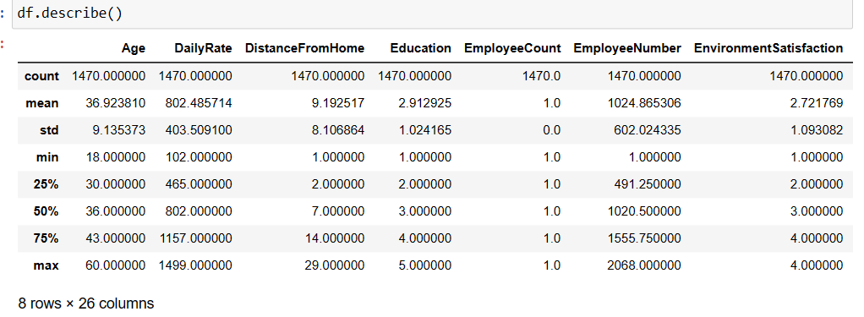
Checking Null Values & Duplicate
Data information
DATA CLEANING
Statistical Information

Slide 6
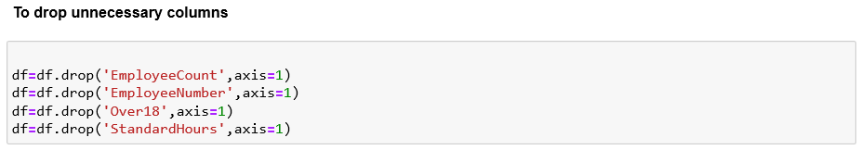
Dropping Non-Relevant Variables
Certain variables do not have any variability in them. Such variables are:
Employee Count: This is just a count of employee and the value it takes is always 1.
Employee Number: This is just a index of employee and the value it takes is taken from 1 to 1469
Over18: This variable describes if an employee is over 18 years of age. It takes the value ‘Yes’ in all cases
.
StandardHours: The standard number of hours an employee works in a week. Its constant value Is 80

Slide 7

EDA Exploratory Data Analytics

Slide 8
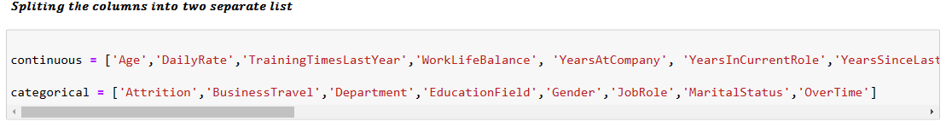
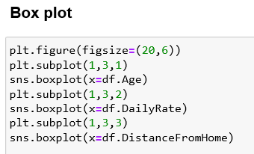

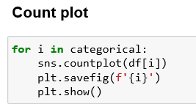
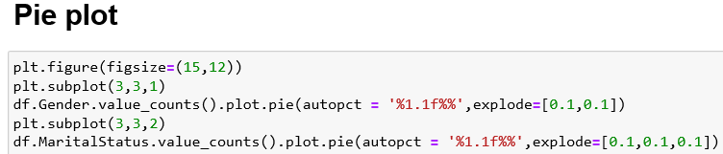
Splitting Columns Categorical And Continuous Variable
Heat Map

Slide 9
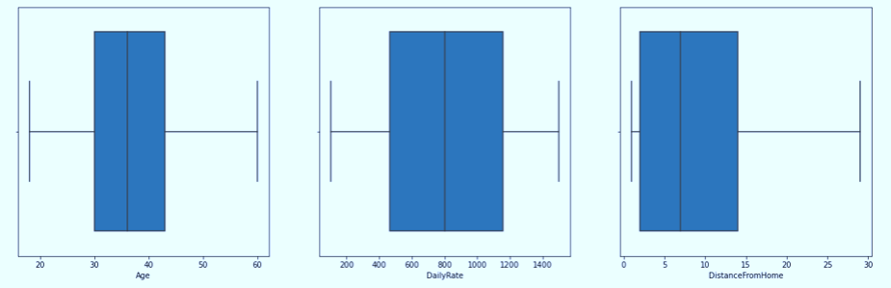
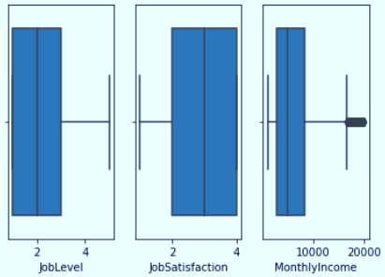
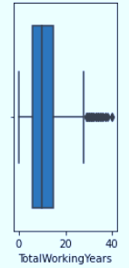
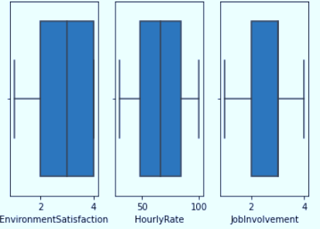
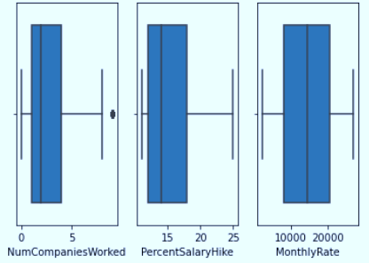
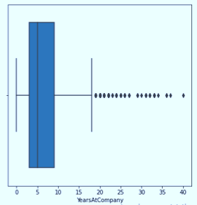
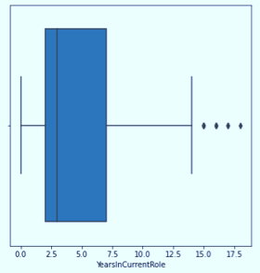
CONTINOUS VARIABLE VISUALIZATION

Slide 10
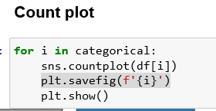
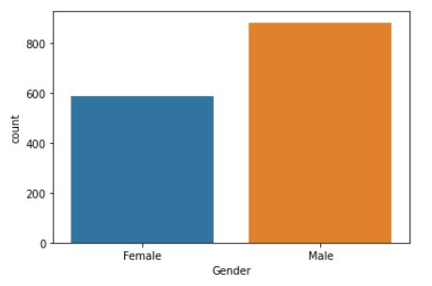
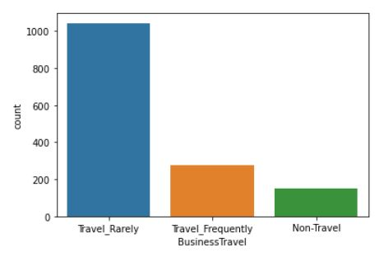
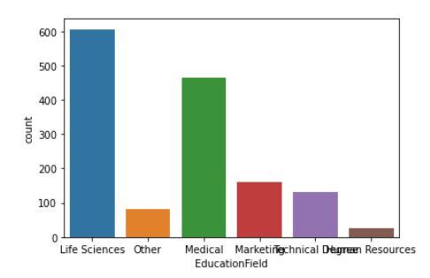
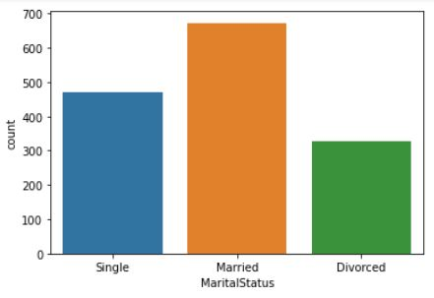
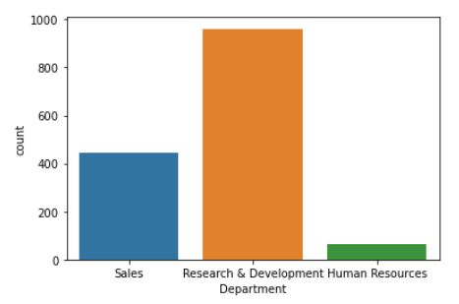
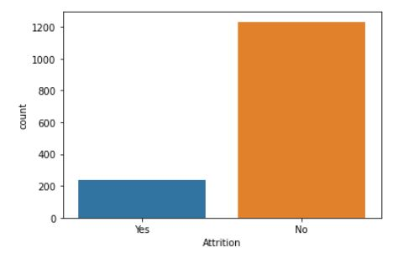
CATEGORICAL VARIABLE VISUALIZATION

Slide 11
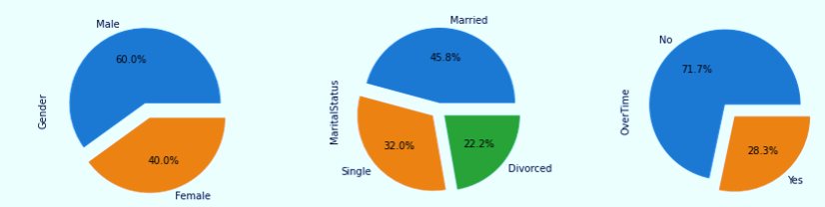
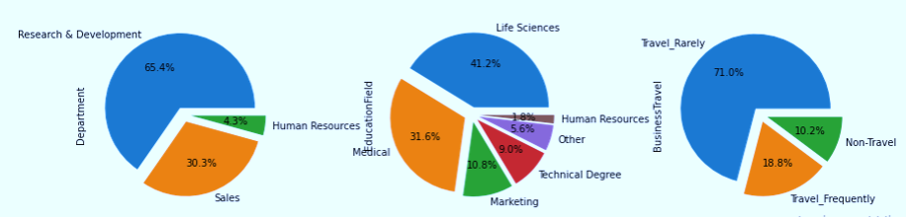
PIE PLOT

Slide 12
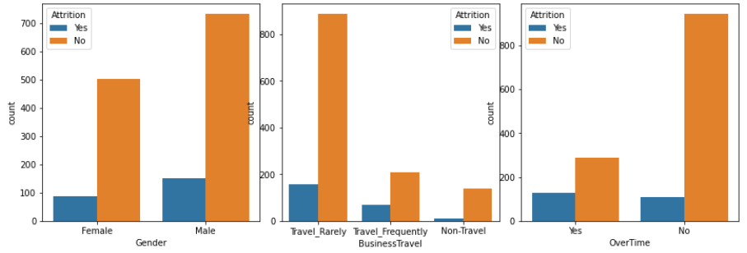
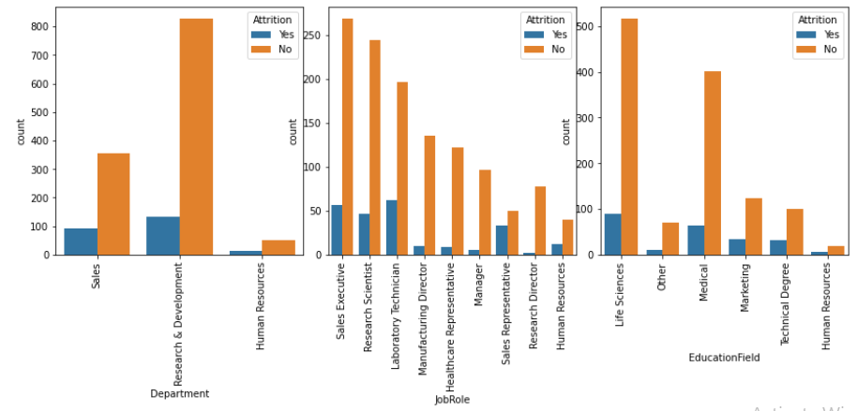
ATTRITION V/S CATEGORICAL VARIABLE
ATTRITION V/S OVER TIME
ATTRITION V/S GENDER
ATTRITION V/S JOB ROLE
ATTRITION V/S DEPARTMENT
ATTRITION V/S BUSINESS TRAVEL
ATTRITION V/S EDUCATION FIELD

Slide 13
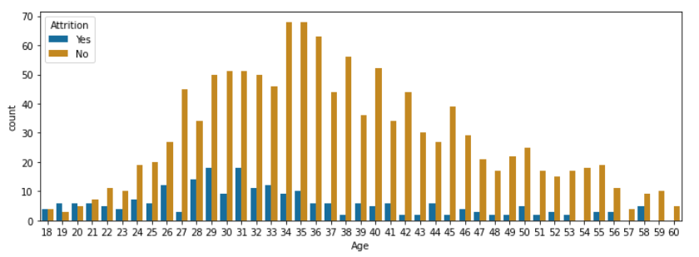
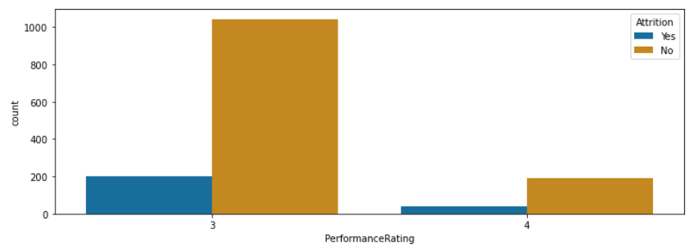
ATTRITION V/S CONTINOUS VARIABLE
ATTRITION V/S AGE
The number of employees leaving the company tends to be higher in the younger age groups between 29 and 31 years. It decreases as age increases, with the lowest attrition rates being in the age group between 54 and 60 years
ATTRITION V/S PERFORMANCE RATING
Employees who have a higher performance rating are less likely to leave the company compared to employees who have a lower performance rating

Slide 14
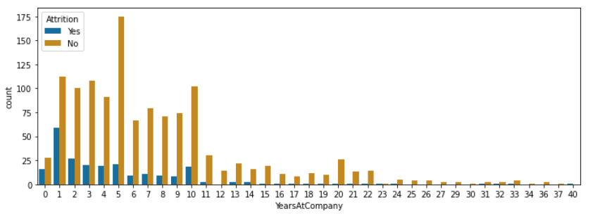
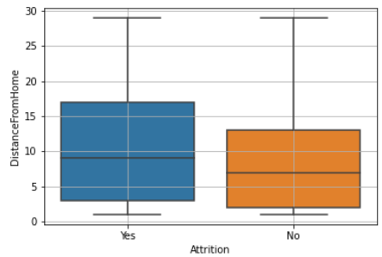
ATTRITION V/S YEARS AT COMPANY
we can observe that employees who have worked at the company for 1-5 years are more likely to leave the company compared to those who have worked at the company for longer periods
ATTRITION V/S DISTANCE FROM HOME
we can observe that the median "Distance From Home" is slightly higher for employees who have left the company compared to those who have stayed

Slide 15
Factors Affecting Attrition
Continuous Variables | attrition rate is higher
Age | Younger(29-31)
Distance From Home | who have to travel longer distances
Job Level | who are at lower job levels
Monthly Income | who earn lower salaries
Total Working Years | employees who have less total working experience
Years at Company | spent fewer years in the company
Years since last promotion | for employees who have not been promoted recently
Work Life Balance. | for employees who report lower work-life balance
Categorical Variables: | Attrition rate is higher for
Gender | male employees
Marital Status | single
Business Travel | for employees who travel frequently
Department | Sales and Human Resources departments.
Job Role | Sales Executive and Laboratory Technician job roles
OverTime | employees who work overtime
SUGGESTIONS
Increase job satisfaction
Address overtime issues
Improve communication: Good communication is essential for employee engagement and retention
Address performance issues : Provide clear performance expectations, regular feedback, and opportunities for skill development and training.

Slide 16

Machine Learning Models

Slide 17
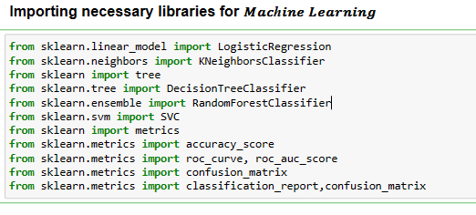
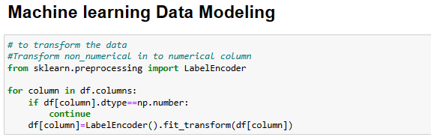
IMPORTING LIBRARIES MACHINE LEARNING

Slide 18
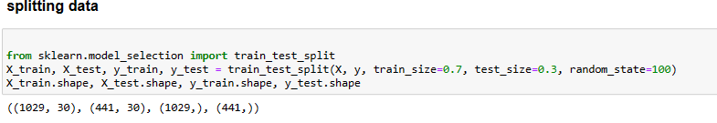
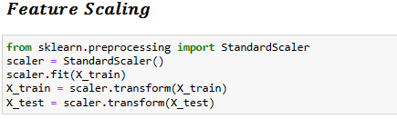
Splitting Dataset
The training data is randomly chosen 1,029 (70%) instances, 172 represents attrited employees, 857 did not attrited.
The test data is the remaining 441 (30%) instances, 65 represents attrited employees, 376 employees that did not attrited.

Slide 19
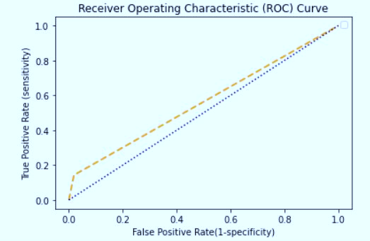
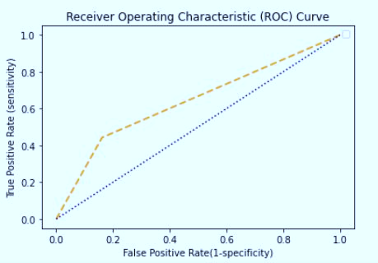
Decision Tree
KNN
Library used : sklearn.tree (DecisionTreeClassifier)
Split used for training and testing the data : 70-30
Feature Scaling was performed after splitting the dataset to avoid information leakage on testing dataset by using Standardization method.
Accuracy : 77%
Recall : 0 - 88 %, 1 – 100 %
Precision : 0 – 100 %, 1 – 83%
Library used : sklearn.neighbors (KNeighborsClassifier)
Split used for training and testing the data : 70-30
Feature Scaling was performed after splitting the dataset to avoid information leakage on testing dataset by using Standardization method.
Accuracy : 80%
Recall : 0 - 84 %, 1 – 100 %
Precision : 0 – 100 %, 1 – 94 %

Slide 20
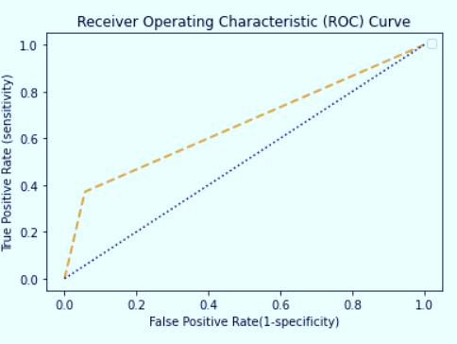
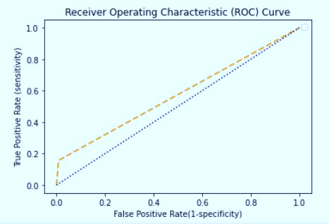
Logistic Regression
Random Forest
Library used : sklearn.linear_model (LogisticRegression)
Split used for training and testing the data : 70-30
Feature Scaling was performed after splitting the dataset to avoid information leakage on testing dataset by using Standardization method.
Accuracy : 84%
Recall : 0 -85%, 1 – 83 %
Precision : 0 – 97 %, 1 – 100%
Library used : sklearn.ensemble (RandomForestClassifier)
Split used for training and testing the data : 70-30
Feature Scaling was performed after splitting the dataset to avoid information leakage on testing dataset by using Standardization method.
Accuracy : 85%
Recall : 0 - 85%, 1 – 100 %
Precision : 0 – 100 %, 1 – 99%

Slide 21
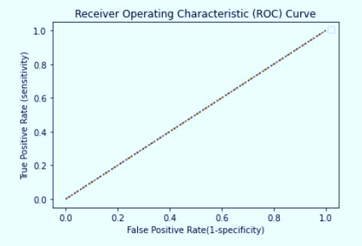
SVM
Library used : sklearn.svm (SVC)
Split used for training and testing the data : 70-30
Feature Scaling was performed after splitting the dataset to avoid information leakage on testing dataset by using Standardization method.
Kernel = ‘rbf’ ,
Accuracy : 86%
Recall : 0 - 87 %, 1 – 100 %
Precision : 0 – 100 %, 1 – 98 %

Slide 22
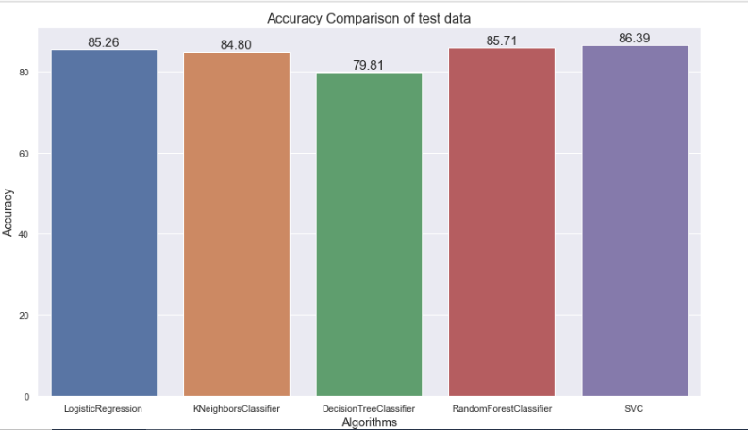
Accuracy Comparison
Based on the accuracy and other performance metrics, it appears that the Support Vector Machine (SVM) model may be slightly better than the Random Forest model for this dataset.
The SVM model had a higher accuracy and higher AUC, indicating better overall performance.

Slide 23

Athira M P
Santhosh Maurya
Shayam Rawat
Aniket Pawar

